Slide 1
Hyper Text Markup Language (HTML)
Notes:
Title - The learning outcome
Subtitle - Duration

Slide 2
In this section, we will discuss:
Introduction to internet, browsing, and emailing.
Introduction to HTML.
Different editors used for webpage development
Applications of HTML
Notes:
Mention the parent topics one by one. This particular learning outcome has 4 parent topics.

Slide 3
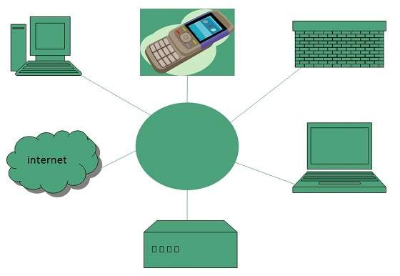
Introduction to Internet, Browsing, and Emailing
Overview of Internet
Internet can be defined as an interconnected network of computers.
The concept of Internet originated in year 1969.
Image Source: https://www.tutorialspoint.com/internet_technologies/internet_overview.htm/
Notes:
Left (White Color space):
Title - Parent Topic
Subtitle - Subtopic 1
Body Text - Description in bullets
Right (Grey Color Space):
Body Text - Relevant image (with source)/code snippet
Put reference links in Speaker Notes
Reference:
https://www.tutorialspoint.com/internet_technologies/internet_overview.htm/

Slide 4

Introduction to Internet, Browsing, and Emailing
Overview of Internet (continued)
A special computer DNS (Domain Name Server) is used to give name to the IP Address so that user can locate a computer by a name.
Internet is accessible to every user all over the world.
Image Source: https://ediacademy.com/blog/ip-address
Notes:
Left (White Color space):
Title - Parent Topic
Subtitle - Subtopic 1
Body Text - Description in bullets
Right (Grey Color Space):
Body Text - Relevant image (with source)/code snippet
Put reference links in Speaker Notes
Reference:
https://www.tutorialspoint.com/internet_technologies/internet_overview.htm/

Slide 5
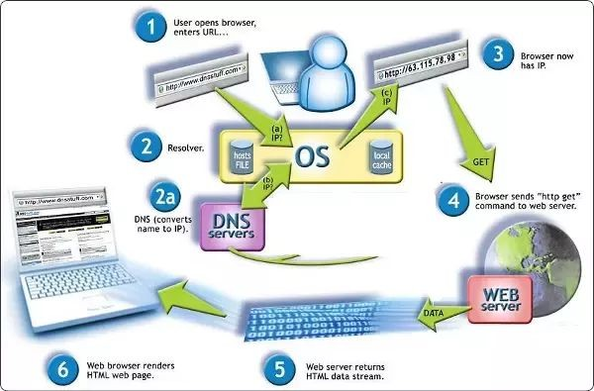
Introduction to Internet, Browsing, and Emailing
Overview of Internet (continued)
Example:
DNS server will resolve a name http://www.edunetworld.com to a particular IP address to uniquely identify the computer on which this website is hosted.
Image Source: https://www.quora.com/What-is-a-DNS-server
Notes:
Left (White Color space):
Title - Parent Topic
Subtitle - Subtopic 1
Body Text - Description in bullets
Right (Grey Color Space):
Body Text - Relevant image (with source)/code snippet
Put reference links in Speaker Notes
Reference:
https://www.tutorialspoint.com/internet_technologies/internet_overview.htm/

Slide 6
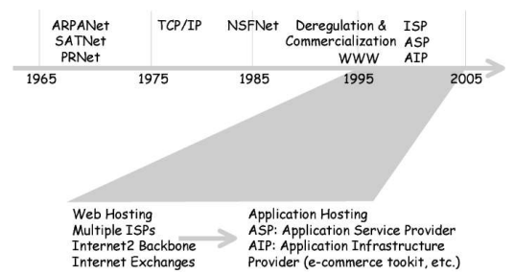
Introduction to Internet, Browsing, and Emailing
Basics of Internet Architecture
Internet architecture is a meta-network, which refers to a congregation of thousands of distinct networks interacting with a common protocol.
Protocol used is TCP/IP.
This protocol connects any two networks that differ in hardware, software and design.
Image Source: https://www.researchgate.net
Notes:
Left (White Color space):
Title - Parent Topic
Subtitle - Subtopic 1
Body Text - Description in bullets
Right (Grey Color Space):
Body Text - Relevant image (with source)/code snippet
Put reference links in Speaker Notes
Reference:
https://www.tutorialspoint.com/internet_technologies/internet_overview.htm/

Slide 7
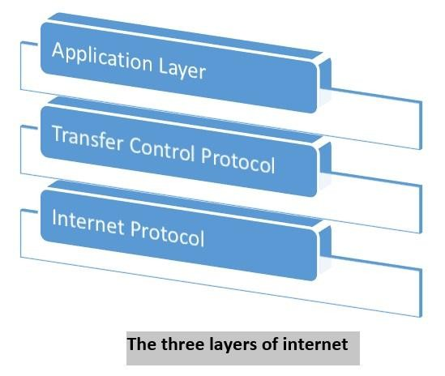
Introduction to Internet, Browsing, and Emailing
Basics of Internet Architecture
Internet Protocol
Transmission Control Protocol
Application Protocol
Image Source: https://www.tutorialspoint.com/computer_concepts/computer_concepts_internet.htm
Notes:
Left (White Color space):
Title - Parent Topic
Subtitle - Subtopic 1
Body Text - Description in bullets
Right (Grey Color Space):
Body Text - Relevant image (with source)/code snippet
Put reference links in Speaker Notes
Reference:
https://www.tutorialspoint.com/internet_technologies/internet_overview.htm/

Slide 8
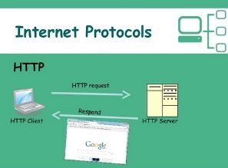
Introduction to Internet, Browsing, and Emailing
Internet Protocol
The Internet Protocol (IP) is the method or protocol by which data is sent from one computer to another on the Internet.
Internet Protocol, or IP, is the method that governs how computers share data across the Internet.
Image Source: https://www.softwaretestinghelp.com/wp-content/qa/uploads/2019/02/internet-protocol-suite-11-638.jpg
Notes:
Left (White Color space):
Title - Parent Topic
Subtitle - Subtopic 1
Body Text - Description in bullets
Right (Grey Color Space):
Body Text - Relevant image (with source)/code snippet
Put reference links in Speaker Notes
Reference:
https://www.tutorialspoint.com/internet_technologies/internet_overview.htm/

Slide 9
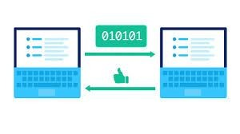
Introduction to Internet, Browsing, and Emailing
Transmission Control Protocol
It provides end to end transmission of data.
It is a very complex protocol as it supports recovery of lost packets.
Image Source: https://cdn.kastatic.org/googleusercontent/DVpBV1WYaAsfuAxR7GQncLGPIt4rbzCh0EmgvCtt8RVtqKPU_yc15ZA1auIn8li_2nR2e8d8YW9tOv96Du7sqcvU
Notes:
Left (White Color space):
Title - Parent Topic
Subtitle - Subtopic 1
Body Text - Description in bullets
Right (Grey Color Space):
Body Text - Relevant image (with source)/code snippet
Put reference links in Speaker Notes
Reference:
https://www.tutorialspoint.com/internet_technologies/internet_overview.htm/

Slide 10
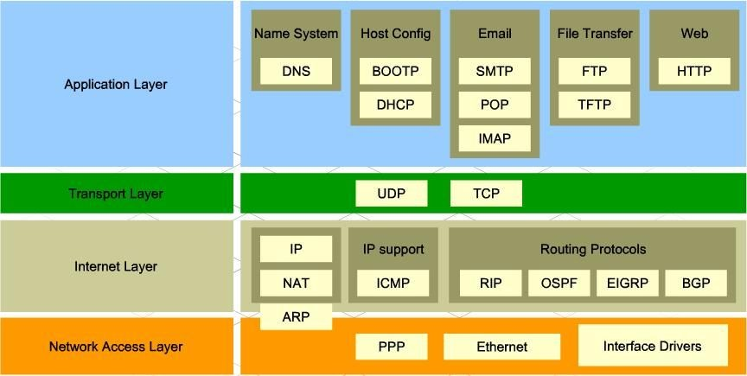
Introduction to Internet, Browsing, and Emailing
Application Protocol
Third layer in internet architecture is the application layer which has different protocols on which the internet services are built.
Some of the examples of internet services include email (SMTP facilitates email feature), file transfer (FTP facilitates file transfer feature), etc.
Image Source: http://walkwidnetwork.blogspot.com/2013/04/application-layer-internet-protocol.html
Notes:
Left (White Color space):
Title - Parent Topic
Subtitle - Subtopic 1
Body Text - Description in bullets
Right (Grey Color Space):
Body Text - Relevant image (with source)/code snippet
Put reference links in Speaker Notes
Reference:
https://www.tutorialspoint.com/internet_technologies/internet_overview.htm/

Slide 11
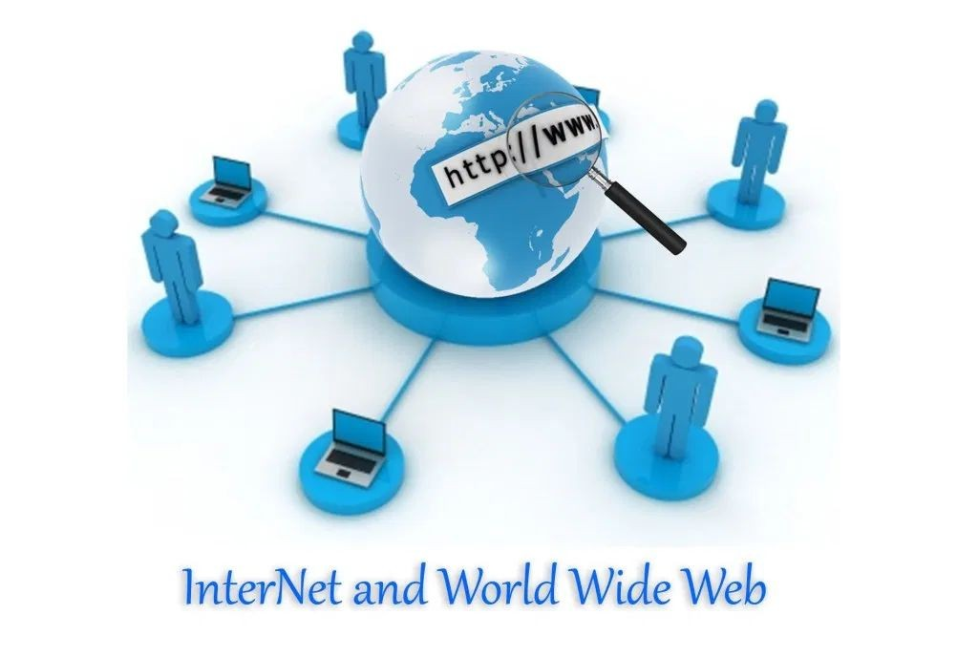
Introduction to Internet, Browsing, and Emailing
Services on Internet
World Wide Web
Websites
Image Source: https://i0.wp.com/informationq.com/wp-content/uploads/2017/11/InterNet-and-World-Wide-Web.jpg?fit=2196%2C1476&ssl=1
Notes:
Left (White Color space):
Title - Parent Topic
Subtitle - Subtopic 1
Body Text - Description in bullets
Right (Grey Color Space):
Body Text - Relevant image (with source)/code snippet
Put reference links in Speaker Notes
Reference:
https://www.tutorialspoint.com/internet_technologies/internet_overview.htm/

Slide 12

Introduction to Internet, Browsing, and Emailing
World Wide Web
Web documents can be linked together, and are called "Hypertext".
It is a way of exchanging information between computers on the Internet, tying them together into a vast collection of interactive multimedia resources.
Tim Berners Lee invented the WWW in 1989.
Image Source: https://i.ytimg.com/vi/mc6Uy368Um8/maxresdefault.jpg
Notes:
Left (White Color space):
Title - Parent Topic
Subtitle - Subtopic 1
Body Text - Description in bullets
Right (Grey Color Space):
Body Text - Relevant image (with source)/code snippet
Put reference links in Speaker Notes
Reference:
https://www.tutorialspoint.com/internet_technologies/internet_overview.htm/

Slide 13
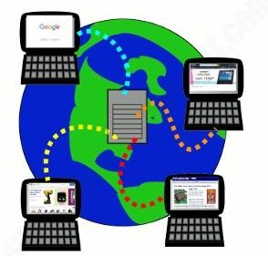
Introduction to Internet, Browsing, and Emailing
World Wide Web (continued)
xTo support hypertext documents, web uses a protocol called "Hypertext Transfer Protocol" (HTTP).
HTTP and Links are foundation for WWW.
Image Source: https://cdn4.explainthatstuff.com/www-conceptual-representation.png
Notes:
Left (White Color space):
Title - Parent Topic
Subtitle - Subtopic 1
Body Text - Description in bullets
Right (Grey Color Space):
Body Text - Relevant image (with source)/code snippet
Put reference links in Speaker Notes
Reference:
https://www.tutorialspoint.com/internet_technologies/internet_overview.htm/

Slide 14

Introduction to Internet, Browsing, and Emailing
Websites
A collection of associated web pages is called "Website".
Websites are housed on the web servers.
Copying a page onto a server is called "publishing" the page, which is also called "posting or uploading".
Image Source: https://miro.medium.com/max/600/0*npRqA-IodJWs4jae.jpg
Notes:
Left (White Color space):
Title - Parent Topic
Subtitle - Subtopic 1
Body Text - Description in bullets
Right (Grey Color Space):
Body Text - Relevant image (with source)/code snippet
Put reference links in Speaker Notes
Reference:
https://www.tutorialspoint.com/internet_technologies/internet_overview.htm/

Slide 15
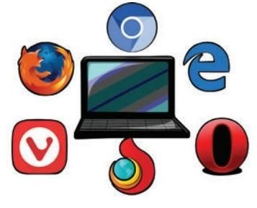
Introduction to Internet, Browsing, and Emailing
Accessing Web Browser
A web browser is a software application which enables a user to display and interact with text, images, videos, music, and other information that could be on a website.
"World Wide Web" or simple "Web" is the name given to all the resources of internet.
Image Source: https://img.brainkart.com/imagebk37/ug2DqoF.jpg
Notes:
Left (White Color space):
Title - Parent Topic
Subtitle - Subtopic 1
Body Text - Description in bullets
Right (Grey Color Space):
Body Text - Relevant image (with source)/code snippet
Put reference links in Speaker Notes
Reference:
https://www.tutorialspoint.com/internet_technologies/internet_overview.htm/

Slide 16
Introduction to Internet, Browsing, and Emailing
Accessing Web Browser (continued)
Installation
Launching a Web Browser
Opening a webpage
Popular Web browsing software
Image Source: https://img.brainkart.com/imagebk37/ug2DqoF.jpg
Notes:
Left (White Color space):
Title - Parent Topic
Subtitle - Subtopic 1
Body Text - Description in bullets
Right (Grey Color Space):
Body Text - Relevant image (with source)/code snippet
Put reference links in Speaker Notes
Reference:
https://www.tutorialspoint.com/internet_technologies/internet_overview.htm/

Slide 17
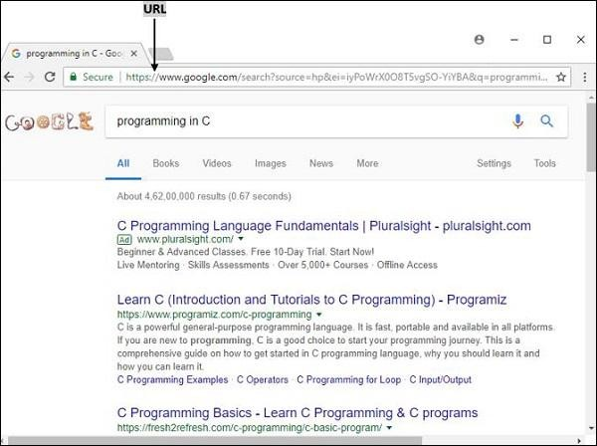
Accessing Web Browser
Installation
Download the browser installer. Click on the blue “Download Chrome” button to begin downloading the browser. ...
Run the installer. The downloaded file should then appear in the bottom of your browser. ...
Install Google Chrome. ...
Finalize the installation.
Image Source: https://www.google.com/search?q=programming+in+c&source
Notes:
Left (White Color space):
Title - Parent Topic
Subtitle - Subtopic 1
Body Text - Description in bullets
Right (Grey Color Space):
Body Text - Relevant image (with source)/code snippet
Put reference links in Speaker Notes
Reference:
https://www.tutorialspoint.com/internet_technologies/internet_overview.htm/

Slide 18
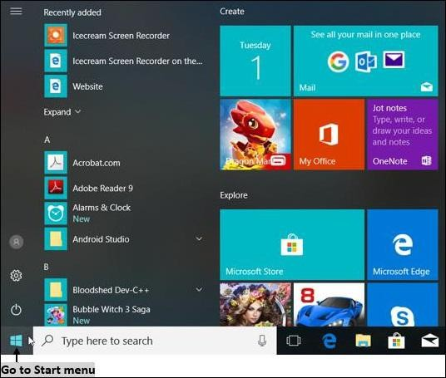
Accessing Web Browser
Launching a Web Browser
Web browser is an application that is located on a computer’s disk. Once you have an internet connection, you can launch a web browser using the following methods
Step 1 − Go to "Start Menu".
Step 2 − From the menu opened, click on the web browser Chrome
Image Source : https://www.tutorialspoint.com/computer_concepts/computer_concepts_accessing_web_browser.htm
Notes:
Left (White Color space):
Title - Parent Topic
Subtitle - Subtopic 1
Body Text - Description in bullets
Right (Grey Color Space):
Body Text - Relevant image (with source)/code snippet
Put reference links in Speaker Notes
Reference:
https://www.tutorialspoint.com/internet_technologies/internet_overview.htm/

Slide 19
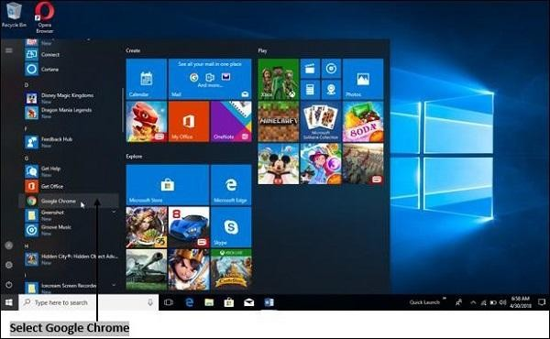
Accessing Web Browser
Launching a Web Browser (continued)
Method 2 − Alternate way is to click the shortcut icon on the taskbar or desktop
Image Source : https://www.tutorialspoint.com/computer_concepts/computer_concepts_accessing_web_browser.htm
Notes:
Left (White Color space):
Title - Parent Topic
Subtitle - Subtopic 1
Body Text - Description in bullets
Right (Grey Color Space):
Body Text - Relevant image (with source)/code snippet
Put reference links in Speaker Notes
Reference:
https://www.tutorialspoint.com/internet_technologies/internet_overview.htm/

Slide 20
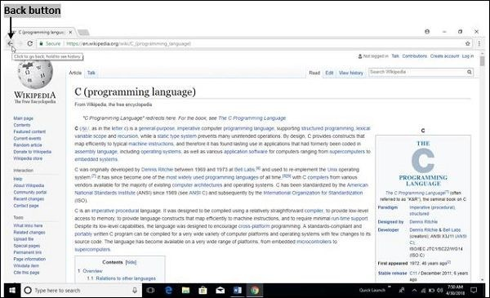
Accessing Web Browser
Opening a webpage
There are several ways to access a web page like using URLs, hyperlinks, using navigating tools, search engine, etc.
Image Source : https://www.tutorialspoint.com/computer_concepts/computer_concepts_accessing_web_browser.htm
Notes:
Left (White Color space):
Title - Parent Topic
Subtitle - Subtopic 1
Body Text - Description in bullets
Right (Grey Color Space):
Body Text - Relevant image (with source)/code snippet
Put reference links in Speaker Notes
Reference:
https://www.tutorialspoint.com/internet_technologies/internet_overview.htm/

Slide 21
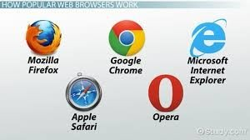
Accessing Web Browser
Popular Web Browsing Software
Google Chrome
Mozilla Firefox
Opera
Internet Explorer
Image Source : https://i.pinimg.com/originals/61/e7/86/61e786d68b16b668f06a7e5191e6c3ed.jpg
Notes:
Left (White Color space):
Title - Parent Topic
Subtitle - Subtopic 1
Body Text - Description in bullets
Right (Grey Color Space):
Body Text - Relevant image (with source)/code snippet
Put reference links in Speaker Notes
Reference:
https://www.tutorialspoint.com/internet_technologies/internet_overview.htm/

Slide 22
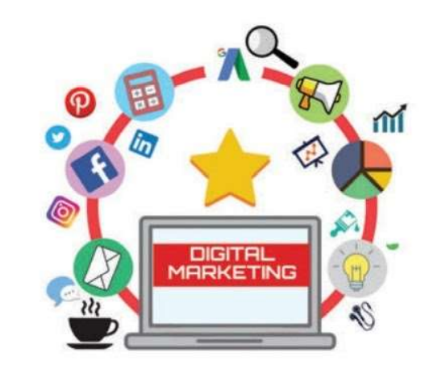
Introduction to Internet, Browsing, and Emailing
Services Available on the Internet
Data Transfer
Internet banking
E-commerce
E-Learning
E-Governance
Browsing and Chatting
E-Mail
Image Source : https://www.brainkart.com/article/Services-Available-on-the-Internet_36837/
Notes:
Left (White Color space):
Title - Parent Topic
Subtitle - Subtopic 1
Body Text - Description in bullets
Right (Grey Color Space):
Body Text - Relevant image (with source)/code snippet
Put reference links in Speaker Notes
Reference:
https://www.tutorialspoint.com/internet_technologies/internet_overview.htm/

Slide 23
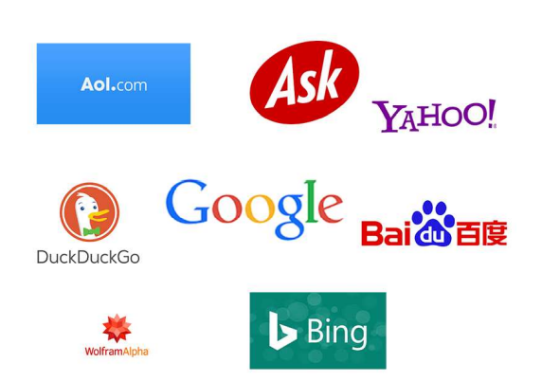
Introduction to Internet, Browsing, and Emailing
Search Engines
Search Engine is an application that allows you to search for content on the web.
Most popular search engines
Google
Bing
Yahoo
Ask
AOL
Image Source : https://wildstonesolution .com/top-search-engines
Notes:
Left (White Color space):
Title - Parent Topic
Subtitle - Subtopic 1
Body Text - Description in bullets
Right (Grey Color Space):
Body Text - Relevant image (with source)/code snippet
Put reference links in Speaker Notes
Reference:
https://www.tutorialspoint.com/internet_technologies/internet_overview.htm/

Slide 24
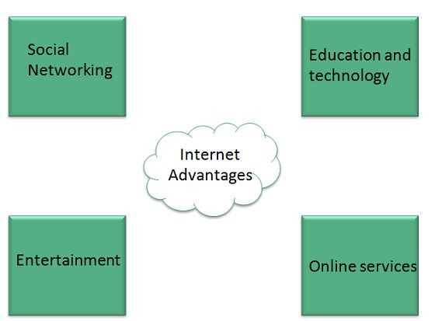
Introduction to Internet, Browsing, and Emailing
Advantages of Internet
Information, knowledge, and learning
Connectivity, communication, and sharing
Address, mapping, and contact information
Banking, bills, and shopping
Selling and making money
Entertainment
Image Source : https://www.tutorialspoint.com/internet_technologies/internet_overview.htm
Notes:
Left (White Color space):
Title - Parent Topic
Subtitle - Subtopic 1
Body Text - Description in bullets
Right (Grey Color Space):
Body Text - Relevant image (with source)/code snippet
Put reference links in Speaker Notes
Reference:
https://www.tutorialspoint.com/internet_technologies/internet_overview.htm/

Slide 25
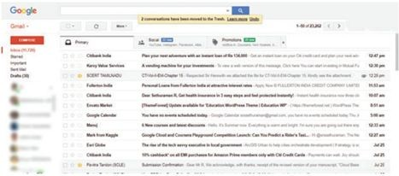
Introduction to Internet, Browsing, and Emailing
Structure and Working of E-Mail
Electronic Mail (email or e-mail) is a method of exchanging messages between people using electronic devices.
Email operates across computer networks, which is primarily called as Internet.
The structure of the E-mail address is username@domain name
Image Source : http://www.brainkart.com/article/Structure-and-Working-of-E-Mail_36840
Notes:
Left (White Color space):
Title - Parent Topic
Subtitle - Subtopic 1
Body Text - Description in bullets
Right (Grey Color Space):
Body Text - Relevant image (with source)/code snippet
Put reference links in Speaker Notes
Reference:
https://www.tutorialspoint.com/internet_technologies/internet_overview.htm/

Slide 26

Introduction to Internet, Browsing, and Emailing
Structure and Working of E-Mail (continued)
An example of E-mail address is raman@gmail.com
An E-mail address consists of two parts separated by @ symbol. The first part Raman is the user name that identifies the address and the second part gmail.com is the domain name of the
E-mail server.
Image Source : https://courses.lumenlearning.com/zeliite115/chapter/reading
Notes:
Left (White Color space):
Title - Parent Topic
Subtitle - Subtopic 1
Body Text - Description in bullets
Right (Grey Color Space):
Body Text - Relevant image (with source)/code snippet
Put reference links in Speaker Notes
Reference:
https://www.tutorialspoint.com/internet_technologies/internet_overview.htm/

Slide 27
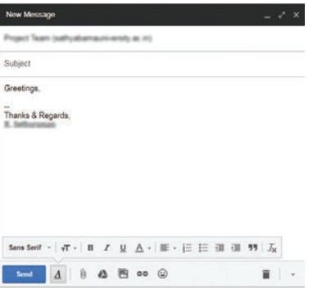
Introduction to Internet, Browsing, and Emailing
How Email works on the Internet ?
To send Internet e-mail, requires an Internet connection and access to a mail server. The standard protocol used for sending Internet e-mail is called
SMTP (Simple Mail Transfer Protocol).
The SMTP protocol is used to both send and receive email messages over
the Internet.
Image Source : http://www.brainkart.com/article/Structure-and-Working-of-E-Mail_36840/
Notes:
Left (White Color space):
Title - Parent Topic
Subtitle - Subtopic 1
Body Text - Description in bullets
Right (Grey Color Space):
Body Text - Relevant image (with source)/code snippet
Put reference links in Speaker Notes
Reference:
https://www.tutorialspoint.com/internet_technologies/internet_overview.htm/

Slide 28
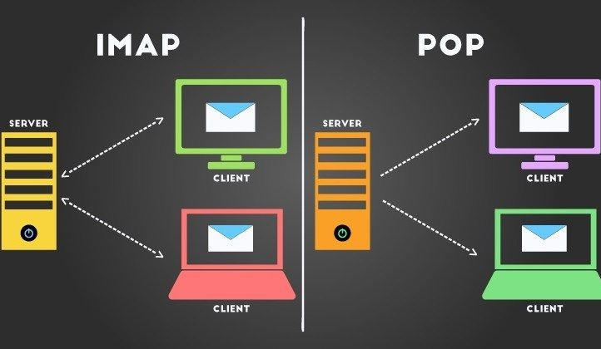
Introduction to Internet, Browsing, and Emailing
How Email works on the Internet ? (continued)
When a message is sent, the email client sends the message to the SMTP server. If the recipient of the email is local the message is kept on the server for accessing by the POP, IMAP or other mail services for later retrieval.
Image Source : https://it.toolbox.com/blogs/alenibric/setting-up-your-e-mail-imap-or-pop-what-to-choose-062719
Notes:
Left (White Color space):
Title - Parent Topic
Subtitle - Subtopic 1
Body Text - Description in bullets
Right (Grey Color Space):
Body Text - Relevant image (with source)/code snippet
Put reference links in Speaker Notes
Reference:
https://www.tutorialspoint.com/internet_technologies/internet_overview.htm/

Slide 29
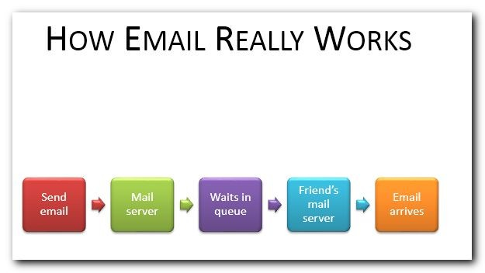
Structure and Working of E-Mail
Structure of an Email message
To
CC
BCC
Subject
Attachment
Body
Signature
Image Source: https://www.techmadeplain.com/2014/email-essentials/

Slide 30

Structure and Working of E-Mail
Advantages
Reliable
Speed
Inexpensive
Waste Reduction
Image Source:https://am7s.com/advantages-of-email/

Slide 31
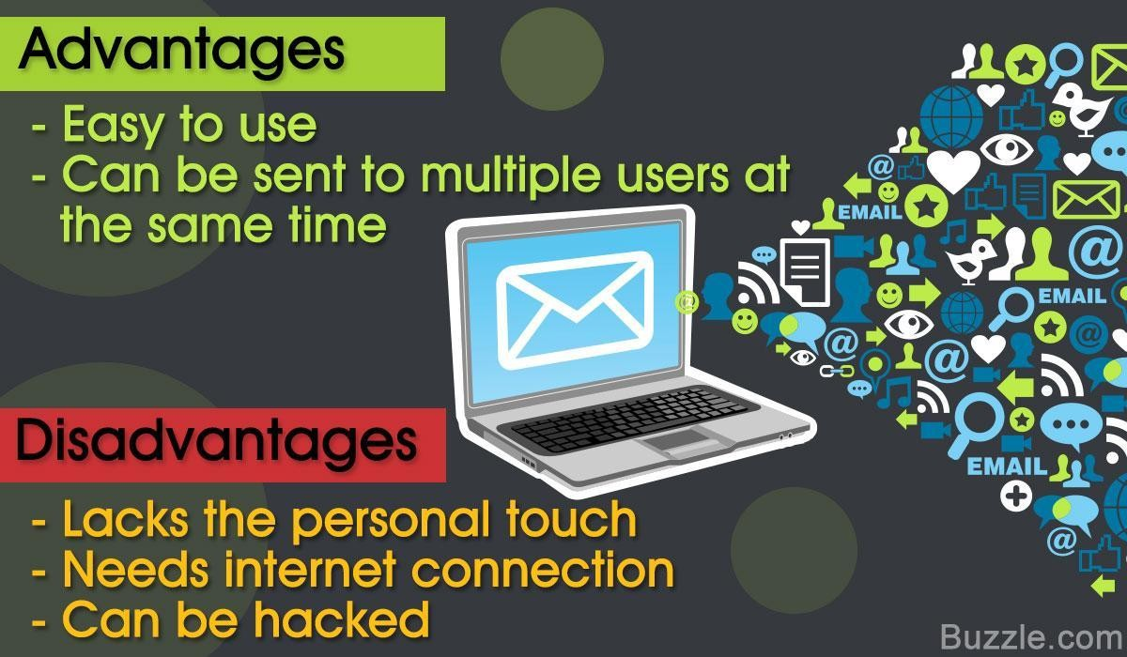
Structure and Working of E-Mail
Disadvantages
Forgery
Overload
Junk
Image Source:https://techspirited.com/advantages-disadvantages-of-email

Slide 32
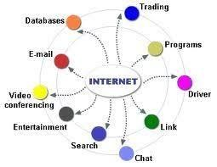
Introduction to Internet, Browsing, and Emailing
Internet Applications
Sending and receiving email.
Searching and browsing information
Copying files between computers.
Conducting financial transactions.
Navigating
Playing interactive games.
Video and music streaming.
Chat or voice communication (direct messaging, video conferencing)
Image Source: https://www.educba.com/what-is-internet-application/

Slide 33
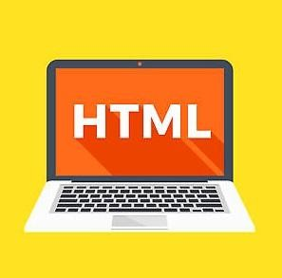
Introduction to HTML
Image Source:https://www.computerhope.com/jargon/h/html-head.htm

Slide 34
Introduction to HTML
What is HTML?
HTML stands for Hyper Text Markup Language
HTML describes the structure of a Web page
HTML consists of a series of elements
HTML elements are represented by tags
Image Source:https://www.computerhope.com/jargon/h/html-head.htm

Slide 35

Introduction to HTML
What is HTML?(continued)
"Hypertext" refers to the hyperlinks that an HTML page may contain.
"Markup language" refers to the way tags are used to define the page layout and elements within the page.
HTML page extension always will be
.html
Image Source: https://www.dreamstime.com/illustration/html.html

Slide 36
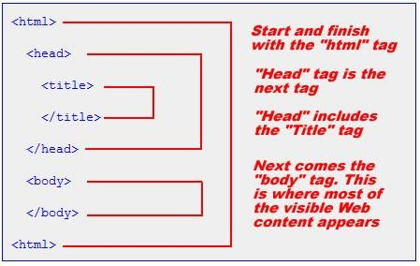
Introduction to HTML
Structure of an HTML document
The <!DOCTYPE html> declaration defines this document to be HTML5
The <html> element is the root element of an HTML page
The <head> element contains meta information about the document
The <title> element specifies a title for the document
The <body> element contains the visible page content
Image Source:https://openlab.citytech.cuny.edu/clarkeadv2450/html/

Slide 37
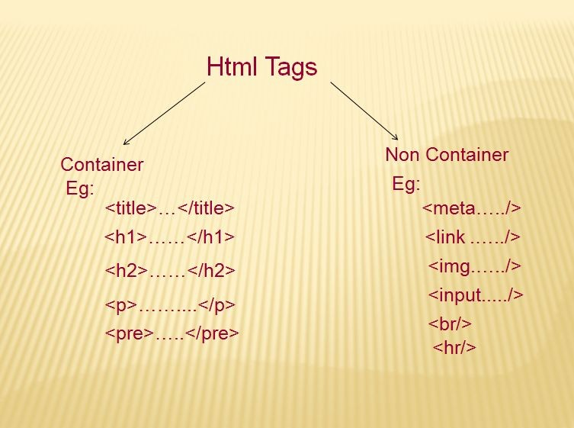
Introduction to HTML
HTML Tags and Attributes
HTML Elements
Heading
Formatting
Colors
Texts and Images
Linking
Table
Div and Span
Lists
Audio and Videos
HTML Forms and Input
Image Source:https://www.phptpoint.com/html-tags/

Slide 38


HTML Tags and Attributes
<!DOCTYPE html>
<html>
<head>
<title>Title of the document</title>
</head>
<body>
<h1>Title of the document</h1>
<p>The first paragraph</p>
<p>The second paragraph, <br/> where line break is inserted </p>
<footer> <p>Author: W3docs team</p> <p><a href="info@w3docs.com">Send message to the author</a>.</p> </footer>
</body>
</html>
HTML Elements
Elements are the fundamentals of Hypertext Markup Language (HTML).
Each HTML document is made of elements that are specified using tags.
Types of HTML Elements
empty elements
Block-level elements
Inline elements

Slide 39
HTML Tags and Attributes
<!DOCTYPE html>
<html>
<body>
Heading
<h1>Heading 1</h1>
<h2>Heading 2</h2>
<h3>Heading 3</h3>
<h4>Heading 4</h4>
<h5>Heading 5</h5>
<h6>Heading 6</h6>
Headings are defined with the <h1> to <h6> tags.
<h1> defines the most important heading.
<h6> defines the least important heading.
</body>
</html>

Slide 40
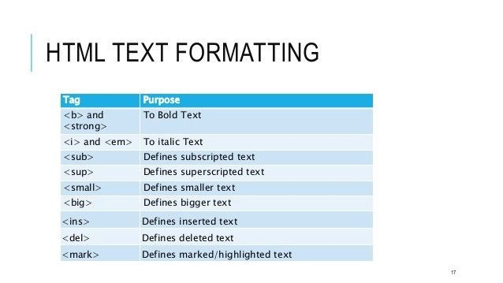
HTML Tags and Attributes
Formatting
HTML also defines special elements for defining text with a special meaning.
The formatting tags are divided into two categories:
physical tags, used for text styling (visual appearance of the text)
logical or semantic tags used to add semantic value to the parts of the text.
Image Source:
https://medium.com/@quadrishah846/the-forgotten-formatting-elements-of-html-4a43048eb0b9

Slide 41
HTML Tags and Attributes
<!DOCTYPE html>
<html>
<body>
<b>This text is bold</b>
<strong>This text is strong</strong>
<i>This text is italic</i>
<em>This text is emphasized</em>
<p>The interest rate is only 10%*</p>
<small>* per day</small>
<p>She likes <del>violets</del>
<ins>snowdrops</ins>․</p>
The formula of water is H<sub>2</sub>O
<p>E = mc<sup>2</sup>
</body>
</html>
Formatting
<b> - Bold text
<strong> - Important text
<i> - Italic text
<em> - Emphasized text
<mark> - Marked text
<small> - Small text
<del> - Deleted text
<ins> - Inserted text
<sub> - Subscript text
<sup> - Superscript text

Slide 42
HTML Tags and Attributes
Colors
<p style="color:red;"> This is a text in green</p>
<p style="color:#8ebf42;"> This is a text in green</p>
There are three ways of how you can
change the color of the text in HTML:
<p style="color:rgba(255,0,0,0.5);">Red paragraph text</p>
Hex color codes
HTML color names
RGB values.

Slide 43
HTML Tags and Attributes
<!DOCTYPE html>
<html lang="en">
<head>
<title>Placing Images in HTML Documents</title>
</head>
<body>
<img src="/examples/images/kites.jpg" alt="Flying Kites">
Images
Images can improve the design and the appearance of a web page.
images are defined with the <img> tag.
It is an empty tag, means it does not have end tag.
</body>
</html>

Slide 44
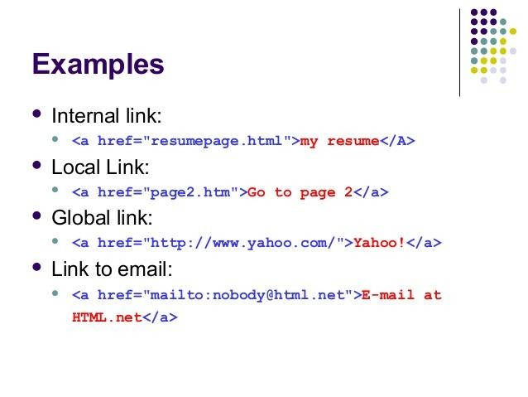
HTML Tags and Attributes
Links
HTML links are hyperlinks.
When you move the mouse over a link, the mouse arrow will turn into a little hand.
Internal Links
An “Internal Link” is a link in your site that navigates the visitor to another page in your website.
Image Source: http://www.corelangs.com/html/links/internal-links.html

Slide 45
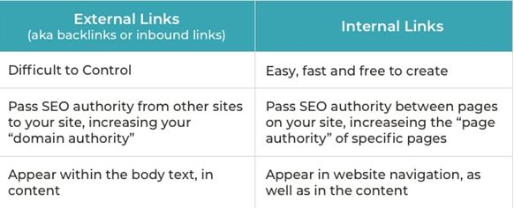
HTML Tags and Attributes
Links
External Links
The “External Link” navigates the visitor away from your site to another website in the internet (like http://google.com).
ImageSource:https://www.orbitmedia.com/blog/internal-linking/

Slide 46
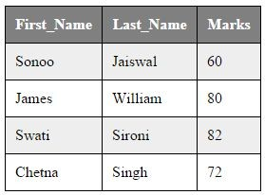
HTML Tags and Attributes
Tables
The HTML tables allow displaying the data (e.g. image, text, link) in columns and rows of cells.
The <table> tag defines an HTML table.
An HTML table consists of the <table> element and one or more <tr>, <th>, and
<td> elements.
ImageSource:https://www.javatpoint.com/html-table

Slide 47
HTML Tags and Attributes
<table style="width:80%;">
<tr>
<th>Month</th>
<th>Date</th>
</tr>
<tr>
<td>January</td>
<td>10.01.2014</td>
</tr>
<tr>
<td>February</td>
<td>10.01.2014</td>
</tr>
</table>
Tables
<tr> element defines a table row
<th> element defines a table header
<td> element defines a table cell.

Slide 48
HTML Tags and Attributes
Div and Span
<div>A Computer Science Portal
<span>Geeks<span></div>
<div> tag is used a as block part of the webpage
<span> tag is used as a inline part of the webpage

Slide 49
HTML Tags and Attributes
<ul style="list-style-type:disc;">
<li>Coffee</li>
<li>Tea</li>
<li>Milk</li>
</ul>
Lists
A list is a record of short pieces of information.
For example:
A shopping list
To-do list
<ol type="A">
<li>Coffee</li>
<li>Tea</li>
<li>Milk</li>
</ol>

Slide 50
HTML Tags and Attributes
Type of Lists
<dl>
<dt>Coffee</dt>
<dd>- black hot drink</dd>
<dt>Milk</dt>
<dd>- white cold drink</dd>
</dl>
Unordered HTML List
Ordered HTML List
HTML Description Lists
Nested HTML Lists

Slide 51
HTML Tags and Attributes
<audio controls>
<source src="horse.ogg" type="audio/ogg">
<source src="horse.mp3" type="audio/mpeg"> Your browser does not support the audio element.
</audio>
<video width="320" height="240" controls>
<source src="movie.mp4" type="video/mp4">
<source src="movie.ogg" type="video/ogg"> Your browser does not support the video tag.
</video>

Slide 52
HTML Tags and Attributes
HTML Forms
<form action="/action_page.php">
<label for="fname">First name:</label><br>
<input type="text" id="fname" name="fname" value="John"><br>
<label for="lname">Last name:</label><br>
<input type="text" id="lname" name="lname" value="Doe"><br><br>
<input type="submit" value="Submit">
</form>
HTML form contains form elements.
Form elements are different types of input elements, like: text fields, checkboxes, radio buttons, submit buttons and more.

Slide 53
HTML Tags and Attributes
HTML Input
Type | Description
<input type="text"> | Defines a single-line text input field
<input type="radio"> | Defines a radio button (for selecting one of many choices)
<input type="submit"> | Defines a submit button (for submitting the form)
The <input> element is displayed in several ways, depending on the type attribute.

Slide 54
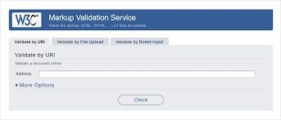
Introduction to HTML
Markup Validation Service
An HTML validator is a quality assurance program used to check Hypertext Markup Language ( HTML ) markup elements for syntax errors.
A validator can be a useful tool for an HTML user who receives data electronically from a variety of input sources.
ImageSource:https://support.modernretail.com/hc/en-us/articles/201127998-W3C-Markup-Validation-Service

Slide 55
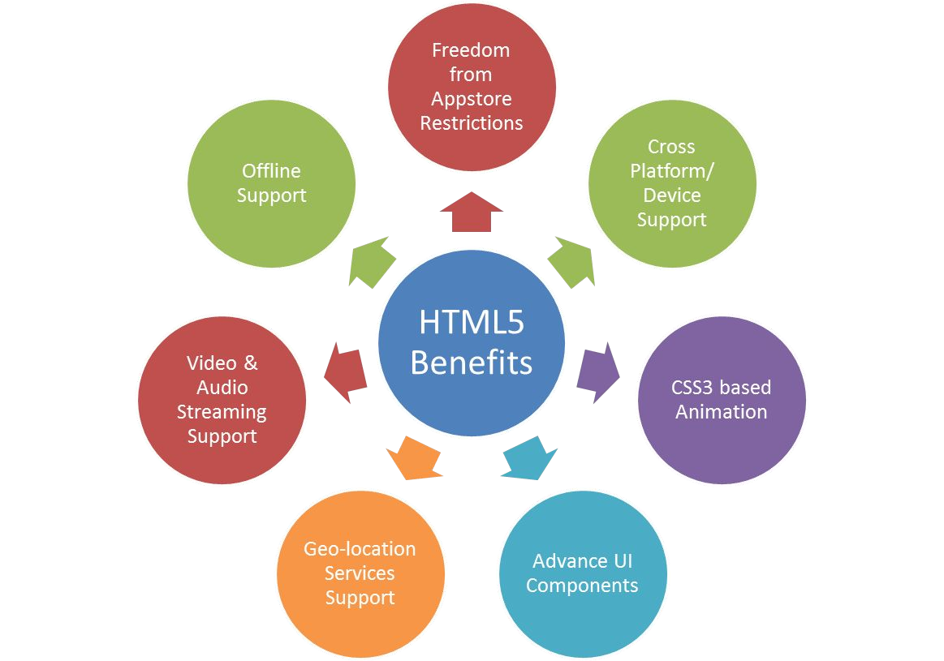
Introduction to HTML
HTML5
HTML5 is the latest standard for browsers to display and interact with web pages.
Features:
semantic elements
graphic elements
attributes of form elements
multimedia elements
Image Source: https://www.markupbox.com/blog/wp-content/uploads/2017/02/html-benefits1.png

Slide 56
Introduction to HTML
HTML5
Page Layout - Semantic Elements
Page Layout
HTML5 Web Forms
Scalable Vector Graphics
HTML5 Media
Image Source: https://www.markupbox.com/blog/wp-content/uploads/2017/02/html-benefits1.png

Slide 57
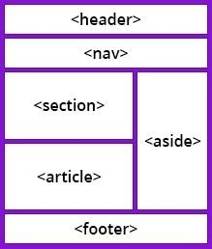
HTML5
Page Layout-Semantic Elements
A semantic element clearly describes its meaning to both the browser and the developer.
Semantic Elements:
<header>
<nav>
<article>
Image Source:https://www.bitdegree.org/learn/html5-semantic-tags

Slide 58
HTML5
Page Layout-Semantic Elements(continued)
<header>
<h1>Welcome to Web123.com</h1>
<nav>
<ul>
<li>Home |</li>
<li>About us |</li>
<li>Contact us</li>
</ul>
</nav>
</header>
<footer>
<p>© Copyright 2019. All rights reserved. </p>
</footer>
<section>
<aside>
<footer>
<address>
<main>

Slide 59

HTML5
Page Layout
Page layout is the part of graphic design that deals with the arrangement of visual elements on a page.
Image Source:https://www.pngbarn.com/png-image-ldidf

Slide 60
HTML5
HTML5 Web Forms
HTML5 Web Forms are used to design the web forms
HTML5 introduces several attributes, input types and elements for markup tool kit.
<form action="/subscribe" method="post">
<fieldset>
<legend>Subscribe to the Newsletter</legend>
<input type="email" name="email">
<button>Ok</button>
</fieldset>
</form>

Slide 61
HTML5
SCALABLE VECTOR GRAPHICS
SVG defines vector-based graphics in XML format.
SVG stands for Scalable Vector Graphics.
Every element and every attribute in SVG files can be animated
<svg width="100" height="100">
<circle cx="50" cy="50" r="40" stroke="green" stroke- width="4" fill="yellow" />
</svg>

Slide 62
HTML5
<object width="100%" height="500px" data="snippet.ht ml"></object>
HTML5 Media
<embed width="400" height="50" src="bookmark.swf">
HTML Plug-ins
Plug-ins can be added to web pages with the <object> tag or
the <embed> tag.
Plug-ins can be used for many purposes: display maps, scan for viruses, verify your bank id, etc.

Slide 63
HTML5
HTML5 Media
<iframe width="420" height="315" src="https://www.youtube.com/embed/tgbNymZ7vqY? autoplay=1">
</iframe
YouTube
The easiest way to play videos in HTML, is to use YouTube.
I

Slide 64
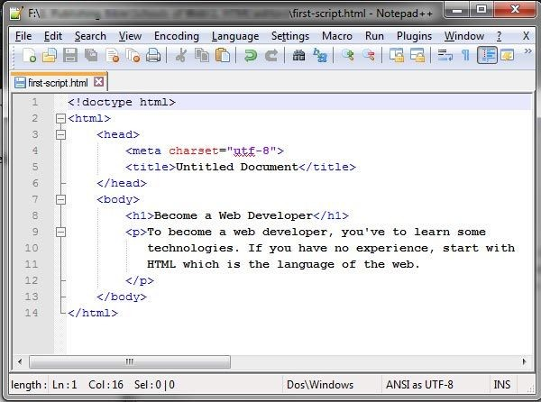
Different editors used for Webpage Development
Image Source: http://schoolsofweb.com/html-editors/

Slide 65
Different editors used for Webpage Development
HTML Editors
HTML text editors are used to create and modify web pages.
HTML codes can be written in any text editors including the notepad.
Image Source: http://schoolsofweb.com/html-editors/

Slide 66
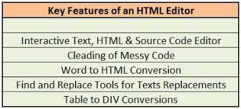
Different editors used for Webpage Development
Common features of HTML Code Editors
Auto-completion.
Adding library for HTML entities.
With the help of Site Explorer, you can view the files in a hierarchical pattern.
Some editors have built-in FTP to upload the files faster.
Advance HTML editors provide support for other languages like CSS and JavaScript.
highlighting syntax errors
Image Source:https://www.goodfirms.co/blog/best-free-open-source-html-editors-software

Slide 67
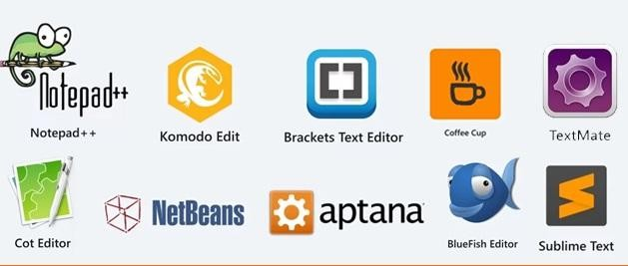
Different editors used for Webpage Development
Different editors used for Web Page
Some of the Popular Html Editors
Phase 5 HTML Editor
Notepad ++
Sublime Text
jEdit HTML Editor
AdobeBrackets
SynWrite Editor
Visualcode Editor
Image Source:https://www.webjaankaari.com/2019/07/10-best-html-editors-list-windows-linux.html

Slide 68
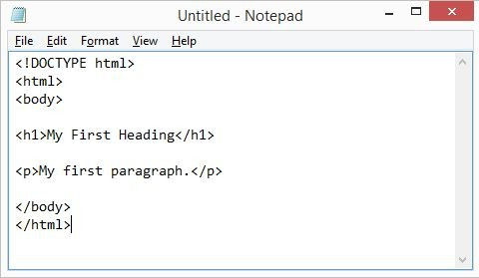
Different editors used for Webpage Development
Different editors used for Web Page(continued)
Notepad: Notepad is a simple text editor. It is an inbuilt desktop application available in Windows OS.
Image Source: https://www.w3schools.com/html/html_editors.asp

Slide 69
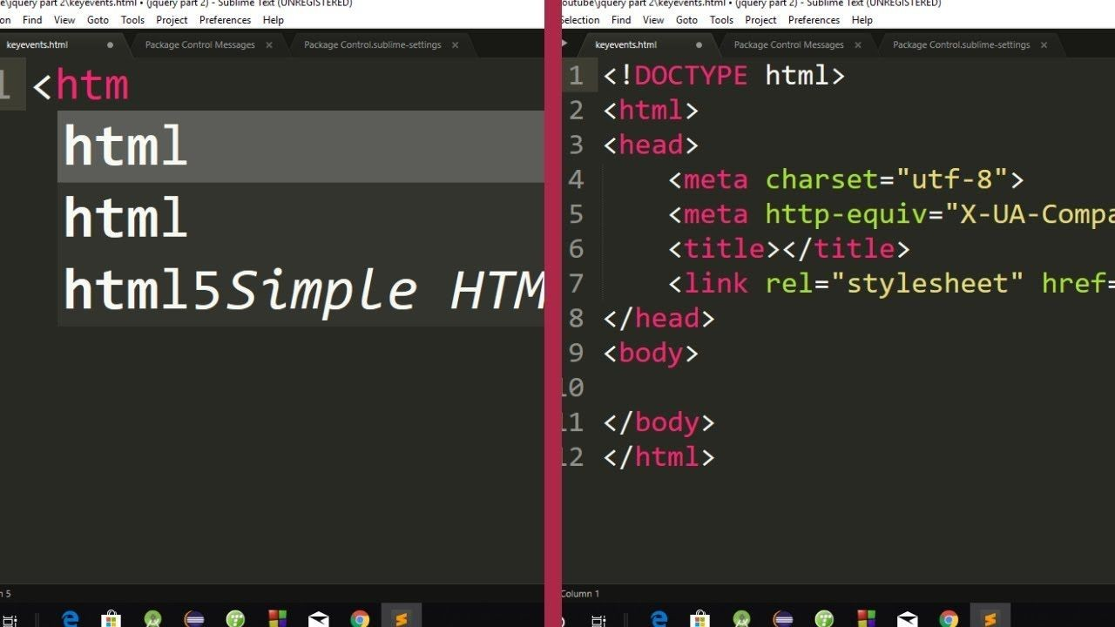
Different editors used for Webpage Development
Different editors used for Web Page(continued)
Sublime Text 3: Sublime is a cross platform code editor tool. It supports all markup languages.
Image
Source: https://www.thapatechnical.com/2018/09/html-css-autocomplete-plugin-in-sublime-Text-3.html

Slide 70
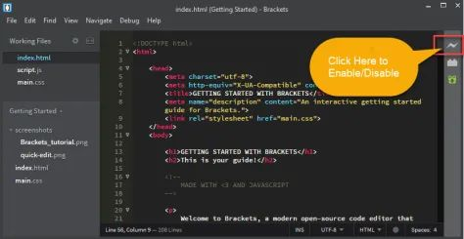
Different editors used for Webpage Development
Different editors used for Web Page(continued)
Bracket: Bracket is an open-source software primarily used for Web development. It provides live HTML, CSS, JavaScript editing functionality.
Image Source:https://www.tutorialbrain.com/text_editor/brackets_live_preview/

Slide 71
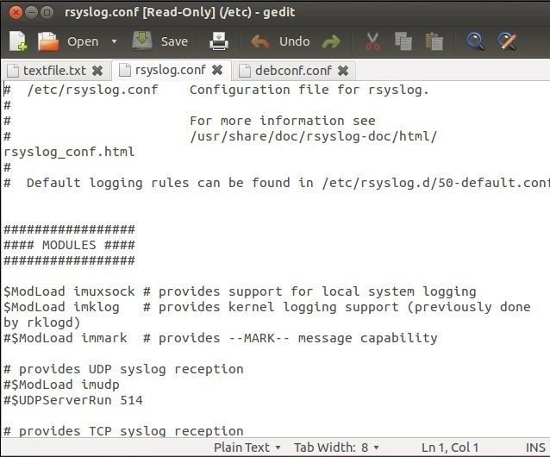
Different editors used for Webpage Development
Different editors used for Web Page(continued)
gedit provides a simple interface from which you have access to a full text editor with programming functions and is compatible with most languages
Image Source https://geek-university.com/linux/gedit-text-editor/

Slide 72
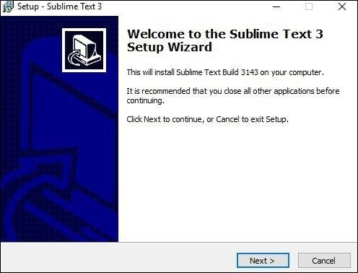
Different editors used for Webpage Development
SublimeText
Installation
Step 1 − Download the .exe package from the official website as shown below https://www.sublimetext.com/3
Step 2 − Now, run the executable file. This defines the environment variables. When you run the executable file, you can observe the following window on your screen. Click Next.
Image Source:https://www.tutorialspoint.com/sublime_text/sublime_text_installation.htm

Slide 73
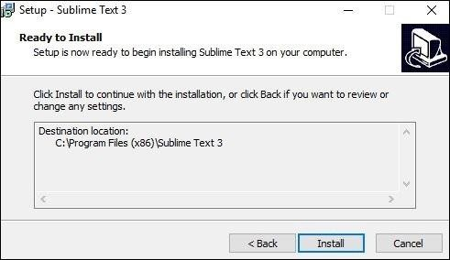
Different editors used for Webpage Development
SublimeText
Step 3 − Now, choose a destination location to install Sublime Text3 and click Next.
Step 4 − Verify the destination folder and click Install.
Step 5 − Now, click Finish to complete the installation.
Step 6 − Upon a successful installation, your editor will appear as shown below
Image Sourcehttps://www.tutorialspoint.com/sublime_text/sublime_text_installation.htm

Slide 74
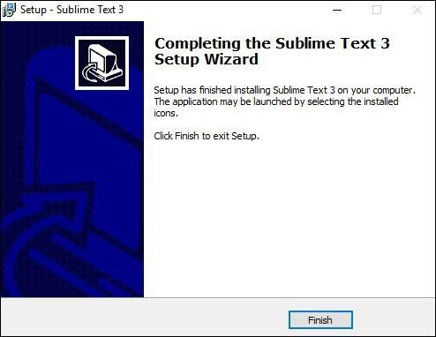
Different editors used for Webpage Development
SublimeText
Features
Syntax Highlight
Auto Indentation
File Type Recognition
Sidebar with files of mentioned directory
Macros
Plug-in and Packages
Image Sourcehttps://www.tutorialspoint.com/sublime_text/sublime_text_installation.htm

Slide 75
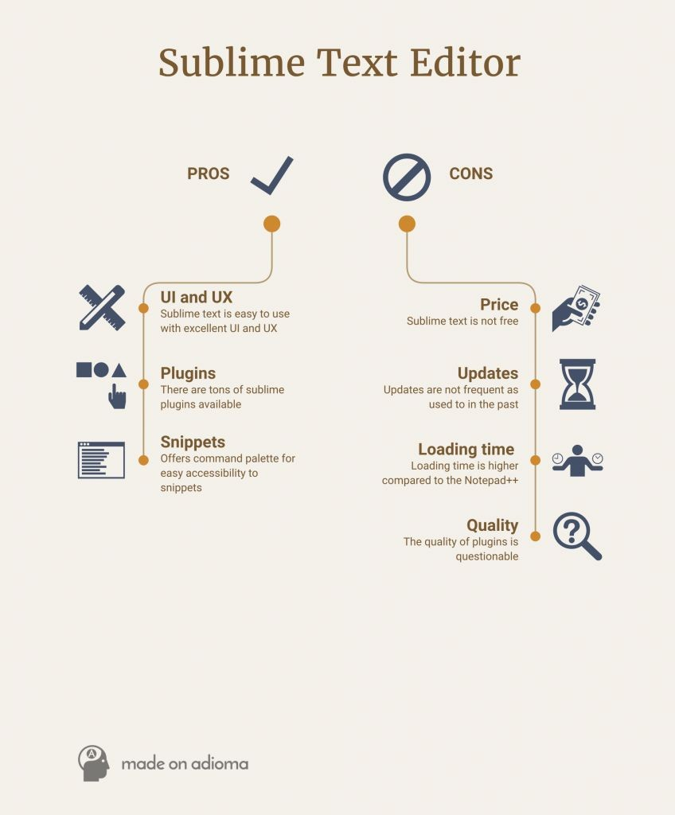
Different editors used for Webpage Development
SublimeText
Pros
Performance: all the operations like opening, closing, searching is fast
Package: lots of packages and themes
Customize: looks nice, also has many theme to choose from, and able to configure using JSON file.
Reliable: no need to do anything else once everything is installed and set up.
Image Source:https://blog.education-ecosystem.com/10-best-text-editors-programming-2016/

Slide 76
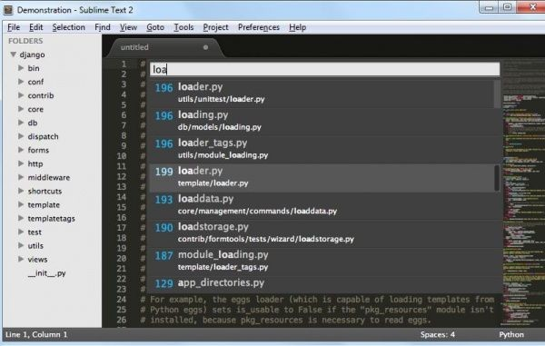
Different editors used for Webpage Development
SublimeText
Cons
Cost: free download, but require $70 license fee, otherwise frequent “buy license” pop-up.
Package: package control is not installed ahead, so some searching needed; powerful only with plugins.
Suggestions: only based on snippet, no context or language based suggestions.
Image Source:https://blog.education-ecosystem.com/10-best-text-editors-programming-2016/

Slide 77
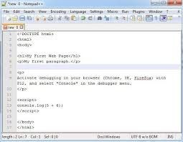
Different editors used for Webpage Development
Notepad++
Features
AutoSaved.
Finding and replacing strings of text with regular expressions.
Guided indentation.
Line bookmarking.
Macros.
Split screen editing and synchronized scrolling.
Image Source:https://blog.education-ecosystem.com/10-best-text-editors-programming-2016/

Slide 78
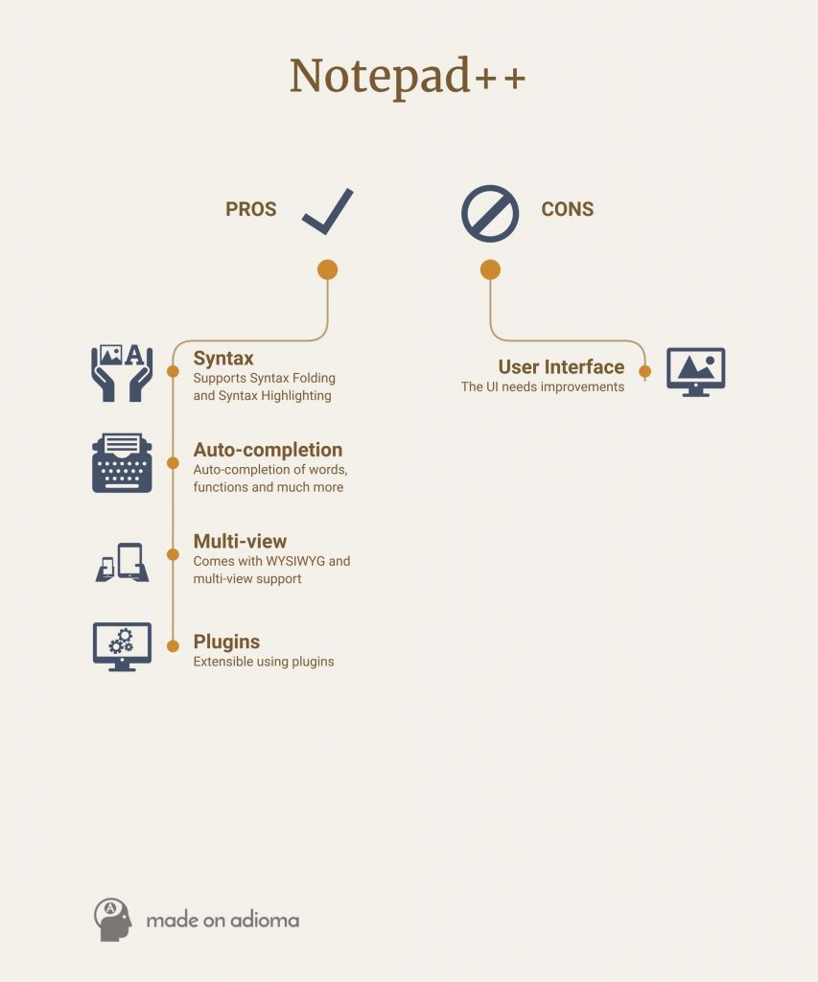
Different editors used for Webpage Development
Notepad++
Pros
Light and fast
Portable
Free
Collaborative editing
Image Source:https://blog.education-ecosystem.com/10-best-text-editors-programming-2016/

Slide 79
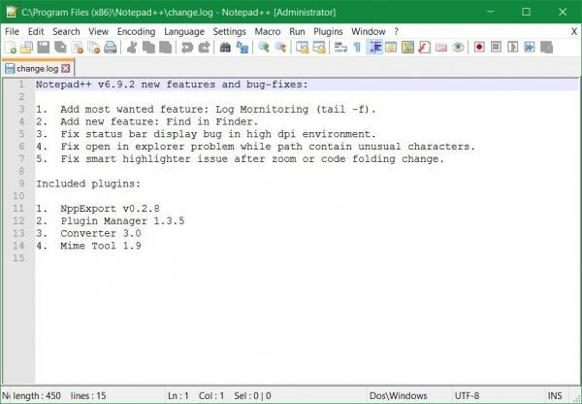
Different editors used for Webpage Developing
Notepad++
Cons
Single platform support – Despite the software being as good as it can to be offered for free, it has limited support. Notepad++ is only available on Windows leaving out macOS and Linux.
Image Source:https://blog.education-ecosystem.com/10-best-text-editors-programming-2016/

Slide 80
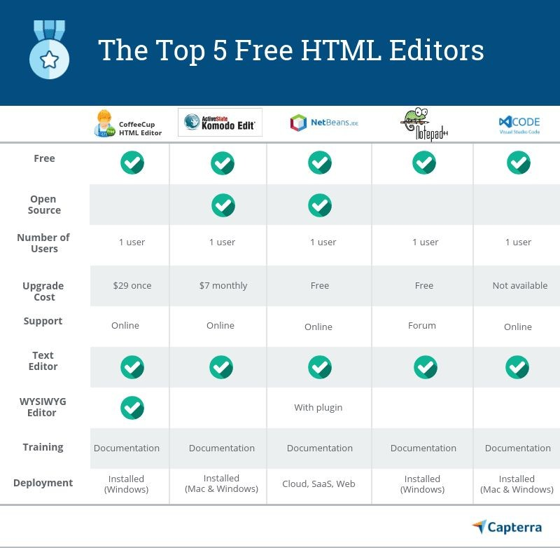
Different editors used for Webpage Developing
Different editors used for Web Page
Comparison
Image Source:https://blog.capterra.com/best-free-html-editors/

Slide 81

Application of HTML
Image Source
https://support.modernretail.com/hc/en-us/articles/201127998-W3C-Markup-Valid

Slide 82
Application of HTML
How its industry using HTML?
The World Wide Web Consortium (W3C) is an international community where Member organizations, full-time staff and the general public work together to develop Web standards.
The best known and widely used Web standards are:
HTML (HyperText Markup Language)
XML (eXtensible Markup Language)
CSS (Cascading Style Sheets)
Image Source
https://support.modernretail.com/hc/en-us/articles/201127998-W3C-Markup-Validation-Service

Slide 83

Application of HTML
How its industry using HTML?
Web Design and Applications
Web of Devices
Web Architecture
Semantic Web
XML Technology
Web Services
Browsers and Authoring Tools
Image Source https://themeforest.net/item/industry-minimal-factory-industry-html-template/20142043

Slide 84

Application of HTML
What is Static Website?
Website is a collection of related web pages that may contain text, images, audio and video.
A static website contains Web pages with fixed content
A static site can be built by simply creating a few HTML pages and publishing them to a Web server.
Image Source: https://www.javatpoint.com/website-static-vs-dynamic

Slide 85

Application of HTML
What is Dynamic Website?
Dynamic website is a collection of dynamic web pages whose content changes dynamically.
It accesses content from a database or Content Management System (CMS).
Dynamic website uses client-side scripting or server-side scripting, or both to generate dynamic content.
Image Source: https://www.javatpoint.com/website-static-vs-dynamic

Slide 86

Application of HTML
Practical Application
Image Source: https://www.graphheneinfotech.com/blog/static-website-vs-dynamic-website/

Slide 87

Application of HTML
Top 10 Uses of HTML
Web pages development
Web document creation
Internet navigation
Cutting edge feature
Responsive images on web pages
Image Source: http://www.mcm-plus.com/en/document-creation.html

Slide 88

Application of HTML
Top 10 Uses of HTML
Client-side storage
Offline capabilities usage
Data Entry support with HTML
Game development usage
Native APIs usage to enrich website
Image Source: https://www.inventivestudio.co.uk/html5/

